Slide 1
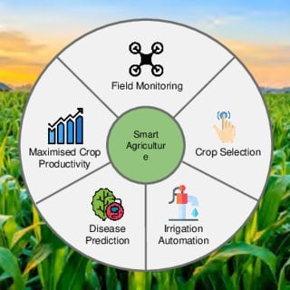
Israel Smart Agriculture and Innovation Research Challenges
KhetHub Internship Program 2026
Research Presentation
Smart Farming Technologies
Agricultural Innovation in Israel
Challenges and Opportunities
Presented by Pranshu Tyagi

Slide 2
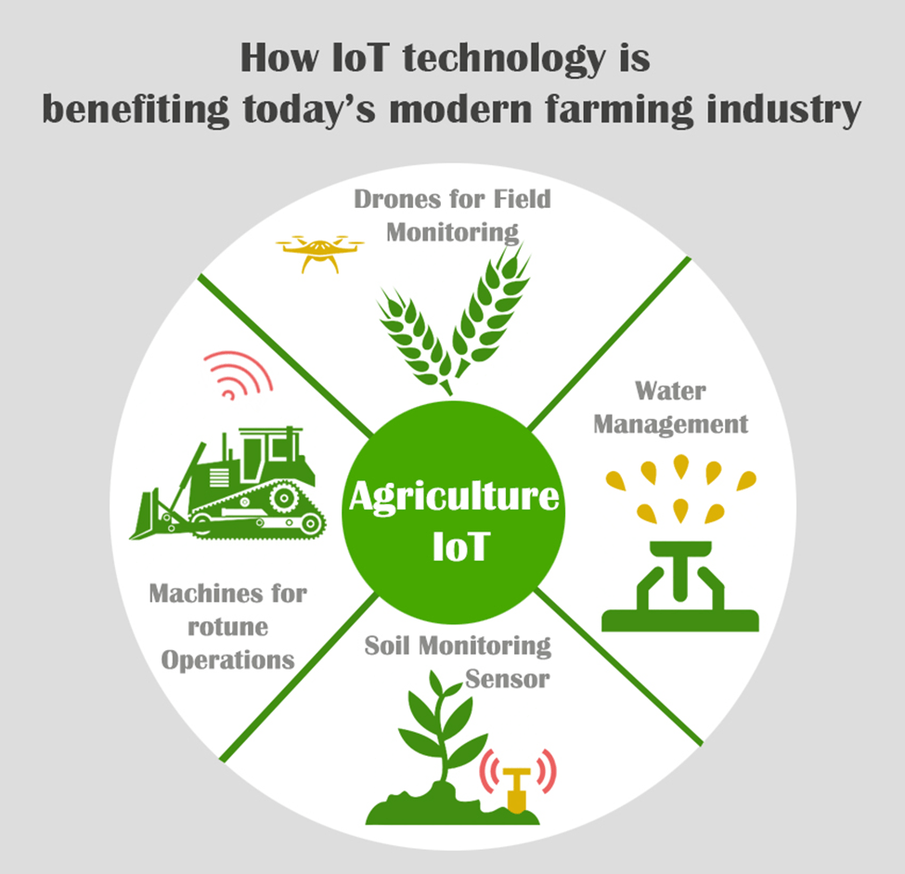
Slide 2 – Introduction to Israeli Agriculture
Israel has limited natural resources
Agriculture developed in arid conditions
Innovation became a national priority
Farmers use advanced technologies
Water efficiency is a key objective
Israel is a global agriculture leader

Slide 3
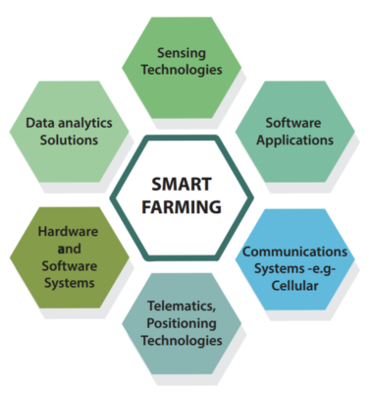
Slide 3 – Smart Agriculture Concept
Precision farming techniques
Data-driven crop management
Real-time monitoring systems
Automated irrigation control
AI-based decision support
Sustainable resource utilization

Slide 4
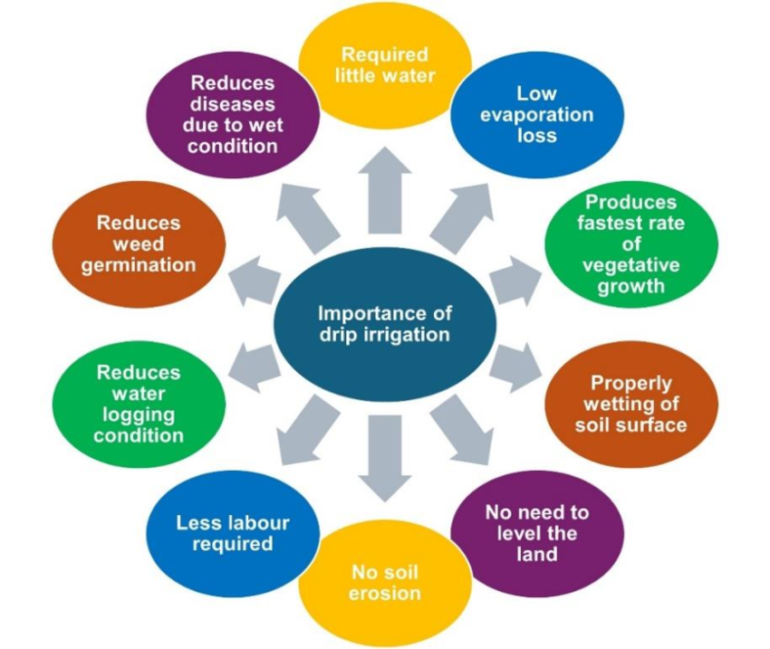
Slide 4 – Drip Irrigation Innovation
Water delivered directly to roots
Minimizes evaporation losses
Increases irrigation efficiency
Suitable for dry regions
Reduces water consumption
Improves crop productivity

Slide 5
Slide 5 – AI and Precision Farming
AI analyzes farm data
Predicts irrigation requirements
Detects crop diseases early
Optimizes fertilizer application
Supports yield forecasting
Enhances farm decision-making

Slide 6
Slide 6 – IoT and Sensor Technologies
Soil moisture sensors
Weather monitoring stations
Temperature and humidity tracking
Wireless farm connectivity
Automated data collection
Continuous field monitoring

Slide 7
Slide 7 – Greenhouse and Controlled Farming
Climate-controlled cultivation
Year-round crop production
Protection from harsh weather
Efficient nutrient management
Reduced pest exposure
Higher quality produce

Slide 8
Slide 8 – Research and Innovation Ecosystem
Strong university research
Government support programs
Startup innovation culture
Industry-academia collaboration
Agricultural technology incubators
Rapid commercialization of ideas

Slide 9
Slide 9 – Major Research Challenges
Climate change impacts
Water scarcity conditions
Soil degradation problems
High technology costs
Data integration complexity
Cybersecurity risks in agriculture

Slide 10
Slide 10 – Challenges for Indian Adoption
Small land holdings
Limited farmer awareness
High initial investment
Inadequate rural connectivity
Maintenance and technical support
Need for local language training

Slide 11
Slide 11 – KhetHub Implementation Opportunity
AI crop advisory platform
Smart irrigation dashboard
IoT sensor integration
Weather-based recommendations
Farmer mobile application
Data analytics for productivity

Slide 12
Slide 12 – Expected Impact on Farmers
Water savings up to 50%
Increased crop yields
Lower irrigation expenses
Early disease identification
Better resource management
Improved farm profitability

Slide 13
Slide 13 – Economic and Environmental Benefits
Reduced groundwater extraction
Lower energy consumption
Sustainable farming practices
Higher agricultural output
Improved food security
Reduced environmental footprint

Slide 14
Slide 14 – Future of Smart Agriculture
AI-driven autonomous farming
Drone-based crop monitoring
Satellite field analytics
Robotics in agriculture
Digital farm marketplaces
Climate-resilient farming systems

Slide 15
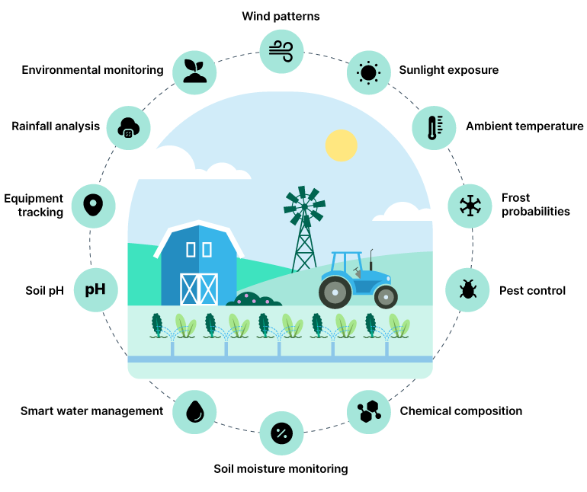
Slide 15 – Conclusion
Israel demonstrates successful smart agriculture
Innovation can overcome resource limitations
AI and IoT improve farm efficiency
Research challenges still remain
India can adapt these technologies gradually
KhetHub can become a leader in digital agriculture

